Slide 1
The Bohr Model of the Hydrogen Atom
(pages 96-97)

Slide 2
energy absorbed
e⁻
energy released
+
n=1
n=2
n=3
n=4
n=5
n→∞

Slide 3
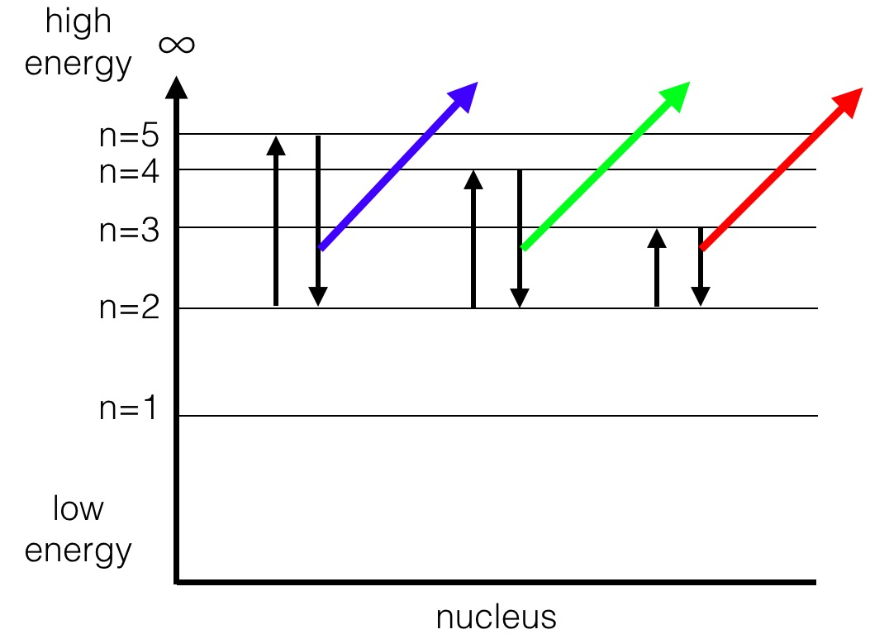

Slide 4
high
energy
∞
n=5
n=4
n=3
n=2
n=1
low
energy
nucleus

